Slide 1
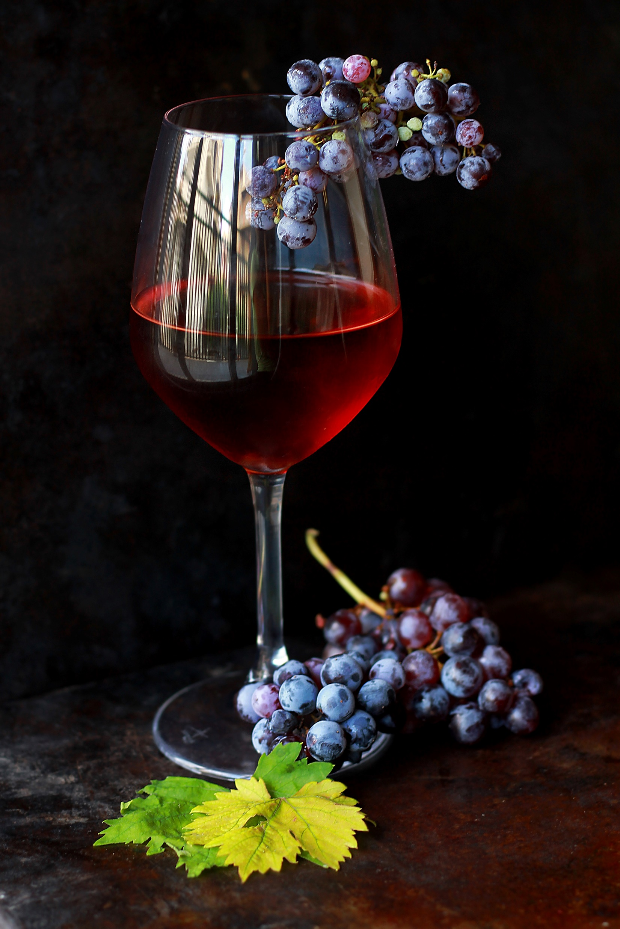

Product name: Wine
NAME: DEEPTI J. MEHER
ROLL NO.: 021330024122
BATCH NAME: Bill Gates

Slide 2
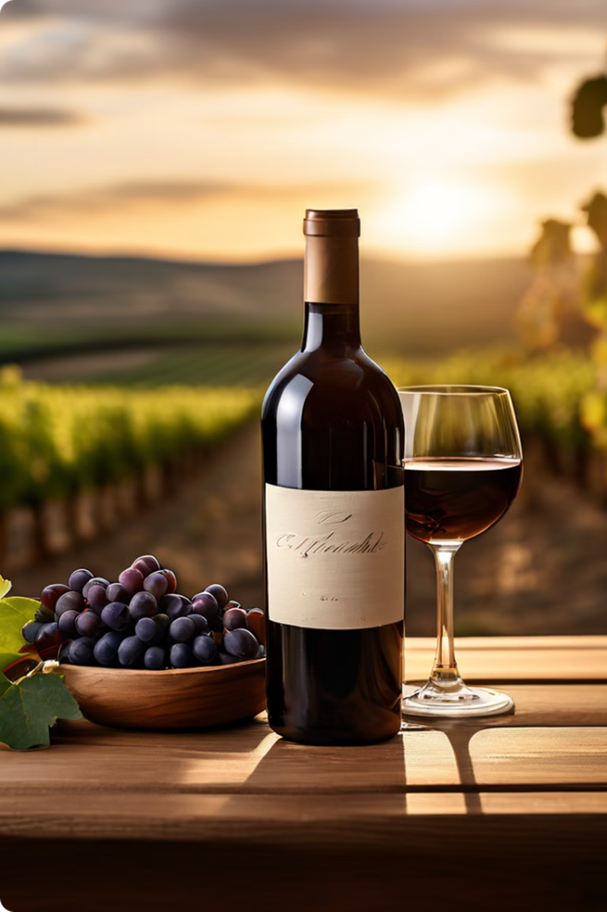
A Journey into Winemaking
Wine is any alcoholic beverage made from fermented fruit juice, but the term is most often used to describe beverages made from fermented grapes. The natural chemical makeup of grapes allows fermentation to occur without adding extra sugar, acid, or other ingredients.

Slide 3
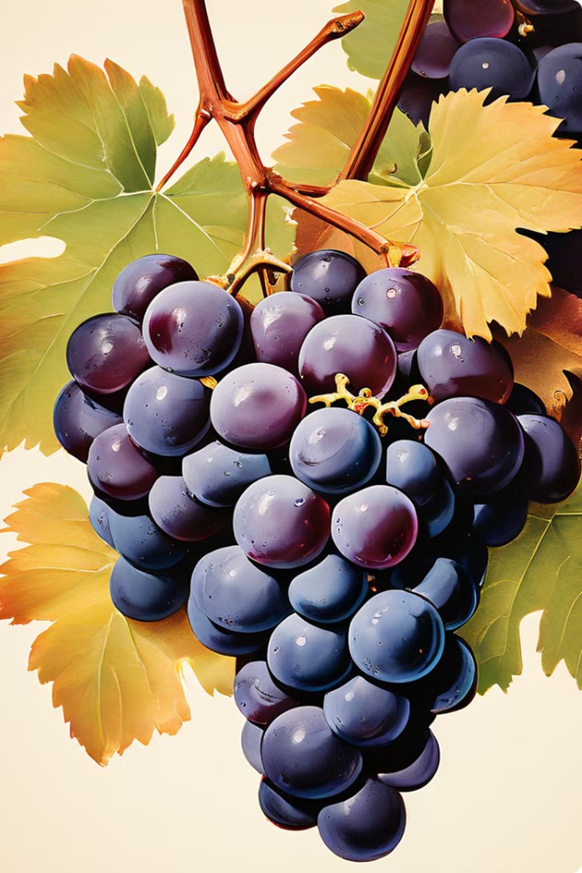
RAW MATERIAL REQUIRED TO MANUFACTURE WINE
1. Grapes (primary raw material)
- Red grapes (e.g., Cabernet Sauvignon, Merlot, Syrah)
- White grapes (e.g., Chardonnay, Sauvignon Blanc, Riesling)
- Rosé grapes (e.g., Grenache, Sangiovese)
2. Yeast (for fermentation)
- Wine yeast (e.g., Saccharomyces cerevisiae)
- Champagne yeast (e.g., Saccharomyces bayanus)
3. Sugar (optional)
- Granulated sugar
- Cane sugar
4. Acid blend (optional)
- Tartaric acid
- Citric acid
Malic acid
5. Pectic enzymes (optional)
- Pectinase
- Pectolyase
6. Fining agents (optional)
- Gelatin
- Egg whites
- Casein
- Kaolin
- Bentonite
7. Oak barrels or chips (optional)
- American oak
- French oak
- Eastern European oak
8. Campden tablets or potassium
metabisulfite (for sterilization and preservation)
9. Water
10. Other ingredients (depending on the type of wine)
- Fruit (e.g., berries, citrus)
- Herbs and spices (e.g., vanilla, cinnamon)
- Botanicals (e.g., flowers, leaves)

Slide 4
DOMESTIC WINE BRANDS (INDIA)
Sula Vineyards (Maharashtra)
Grover Zampa Vineyards (Maharashtra)
Fratelli Wines (Maharashtra)
Chateau Indage (Maharashtra)
York Winery (Maharashtra)
Nine Hills (Maharashtra)
Krsma Estates (Karnataka)
Big Banyan (Karnataka)
Good Earth (Maharashtra)
Reveilo (Maharashtra)

Slide 5
 | TOOL | DURATION
Harvesting and Crushing | Grape harvesters Crushers (e.g., crusher-destemmer, roller crusher) Sorting tables | 1-3 Days
Fermentation | Fermentation tanks (stainless steel, concrete, or oak) Temperature control systems Pumping equipment (e.g., centrifugal pumps, diaphragm pumps) Yeast inoculation equipment | 7-14 days
Maceration and Pressing | Maceration tanks Presses (e.g., hydraulic presses, pneumatic presses) Must pumps | 3-7 days
Clarification and Stabilization | Centrifuges Filters (e.g., plate filters, cartridge filters) Fining agents (e.g., gelatin, egg whites) Racking equipment | 1-3 months
Aging and Maturation | Oak barrels Stainless steel tanks Concrete eggs Wine transfer pumps | 3-24 months
Bottling and Packaging | Bottling lines Labeling machines Corking or screw-capping equipment Packaging materials (e.g., cases, cartons) | 1-3 Days

Slide 6
The Transformation Process
Harvesting & Crushing
Fermentation
Maceration and Pressing
Clarification & Stabilization
Aging & Maturation
Bottling & Packaging
Quality Control & Testing

Slide 7
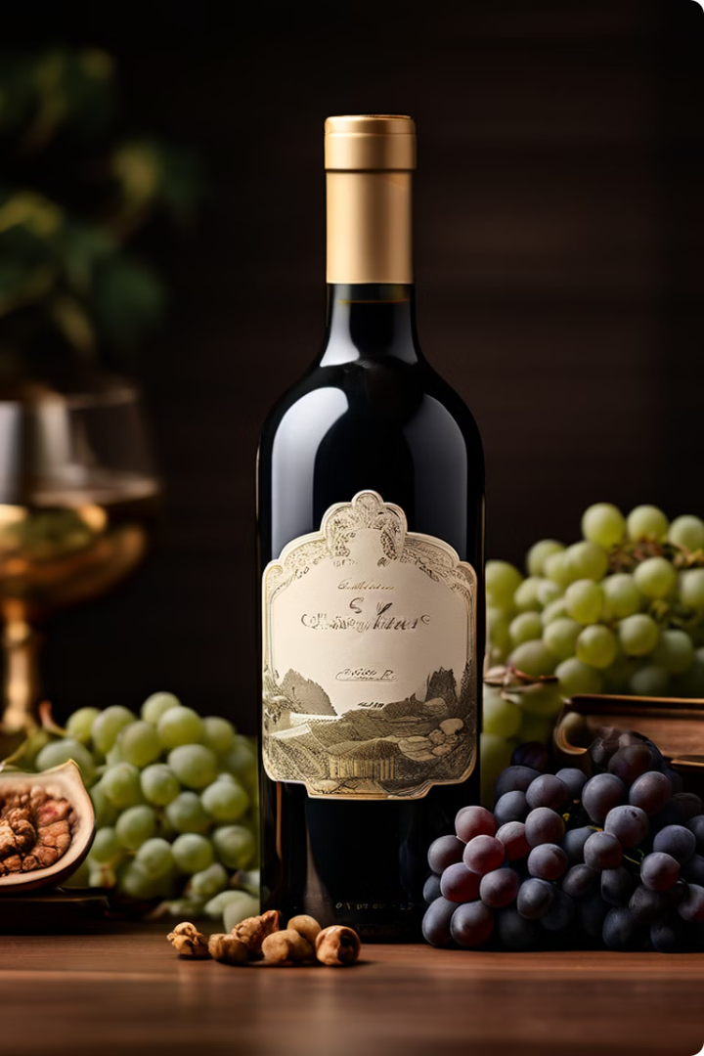
The finished wine product is typically packaged in:
Glass bottles with cork or screw-cap closures
Cartons or bag-in-box containers
Cans or kegs (for some wine styles)
The finished product is now ready for:
Distribution to retailers and restaurants
Export to international markets
Direct sales to consumers through winery tasting rooms or online channels
Quality control and sensory evaluation by wine critics and consumers.
The Art of Winemaking: Finished Product

Slide 8
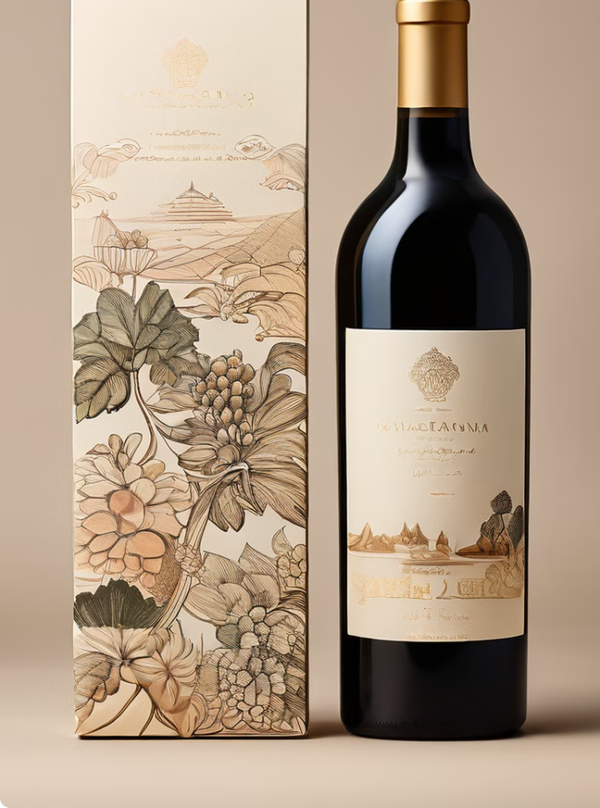
Packaging, material handling, warehousing, transportation, inventory management of wine product
Packaging:-
Glass bottles with cork or screw-cap closures
Cartons or bag-in-box containers
Cans or kegs (for some wine styles)
Labels and packaging materials (e.g., paper, plastic, foil)
Material Handling:-
Palletization: bottles are placed on pallets for efficient storage and transportation
Depalletization: pallets are disassembled for bottling or shipping
Forklifts, conveyor belts, and pumps for moving wine and packaging materials
Warehousing:-
Temperature-controlled storage facilities (12-15°C/54-59°F) for aging and storing wine
Humidity control (50-70%) to prevent cork drying and label damage
Secure storage for high-value or sensitive products
Inventory management systems for tracking stock levels and locations

Slide 9
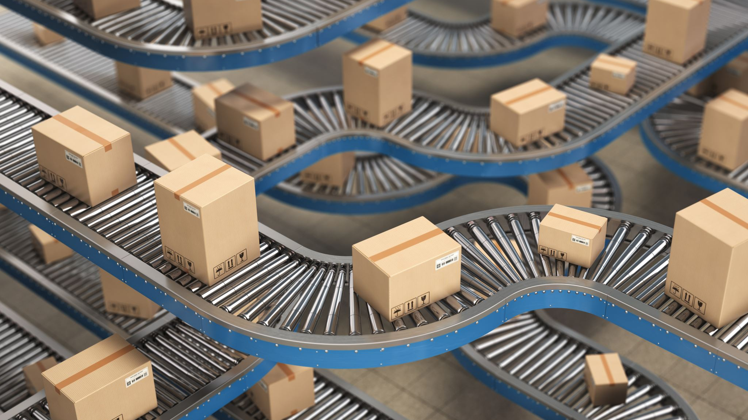
Transportation:-
Trucks or tractor-trailers for local and regional transportation
Refrigerated containers for long-distance transportation
Ocean freight for international exports
Air freight for urgent or high-priority shipments
Inventory Management:-
Tracking stock levels and locations using inventory management software
Monitoring product age and rotation to ensure the oldest products are sold first
Managing inventory levels to prevent stockouts or overstocking
Regular audits and cycle counts to ensure accuracy

Slide 10

Conclusion:
"Winemaking is a craft that blends science, tradition, and creativity. From selecting the finest grapes to the intricate fermentation and aging processes, each step is crucial in creating a unique and enjoyable beverage. This journey from wine to bottle not only highlights the complexity and skill involved but also celebrates the rich culture and history of wine. Whether enjoyed at a special occasion or a casual dinner, wine connects us to the artistry and dedication of winemakers around the world. Thank you for exploring this fascinating process with me."

Slide 11

THANK YOU

